Slide 1
Model Interpretation

Slide 2
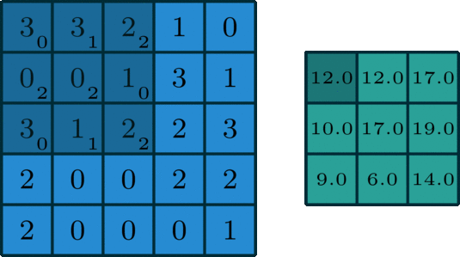


What is Model Interpretation?
??????

Slide 3
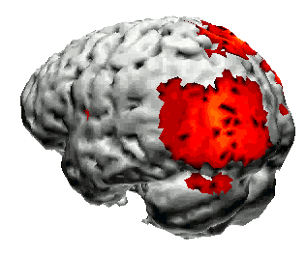
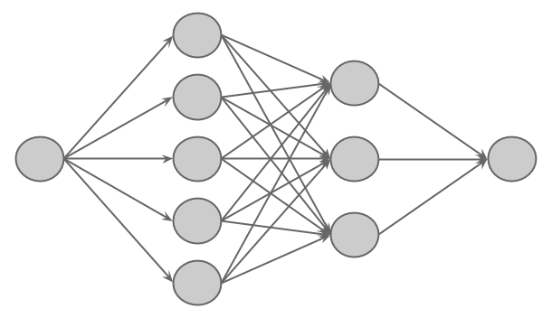
Interpretability is Important
Understanding Data
The role of input variables
Is the data even useful?
Understanding Models
Why certain “decisions” were made
Ethical/Legal understanding when things go wrong
Improving models
Otherwise we’re just guessing
Improvement is often haphazard and narrow
Open Science
We are obligated to give everyone a chance to understand what’s going on
We interpret neurological function
Why not neural networks?

Slide 4

Are DNN’s “Black Boxes”?
“Black Box” models are typically only described in terms of inputs and outputs
Usually not!
Weights are available!
Gradients are available!
Architecture is available!
DNNs are not easily human-interpretable.
Methods for interpreting black boxes can still help!

Slide 5

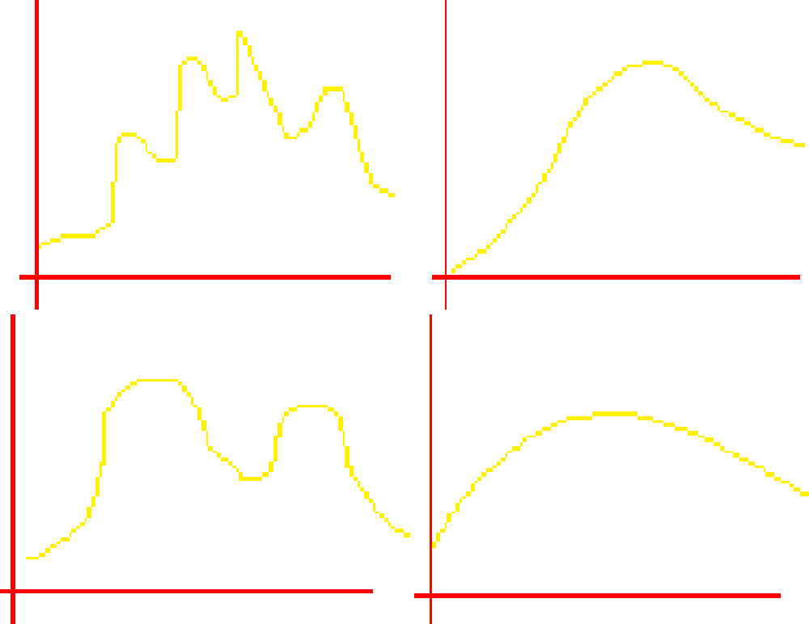
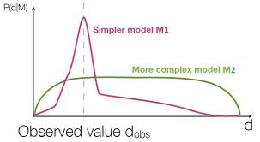
Ancient Methods
Model A B
Measuring Gradient Norms
More sensitive models have larger measures
Cross Validation
Hold out a validation set to compare models
Bayesian Model Comparison
Automatic penalization of complex models
Weight Pruning
Remove weights that minimally influence output
Data X1 X2
Cross Validation
Bayesian Model Comparison

Slide 6
Sensitivity Analysis

Slide 7
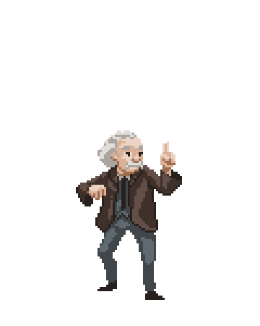


How Inputs affect Outputs
Copyright: Superinteressante magazine, Editora Abril

Slide 8
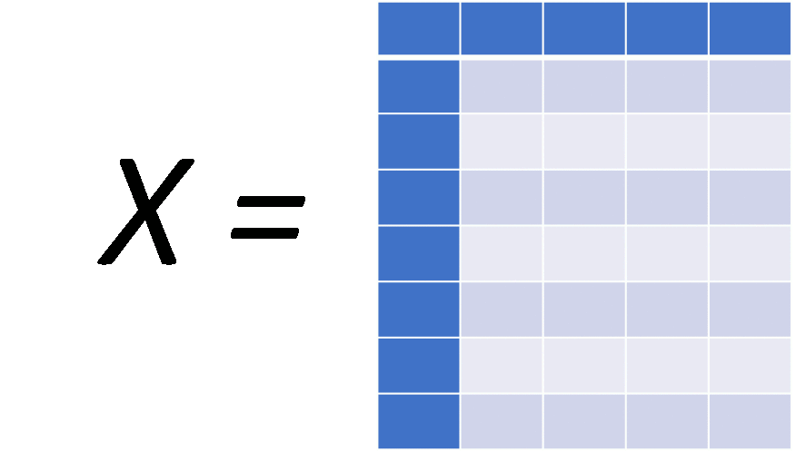
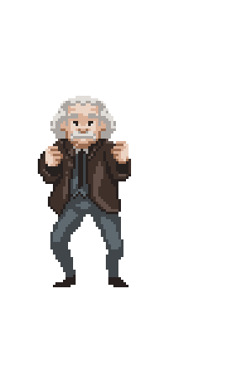
How Inputs affect Outputs
Copyright: Einat Naaman

Slide 9
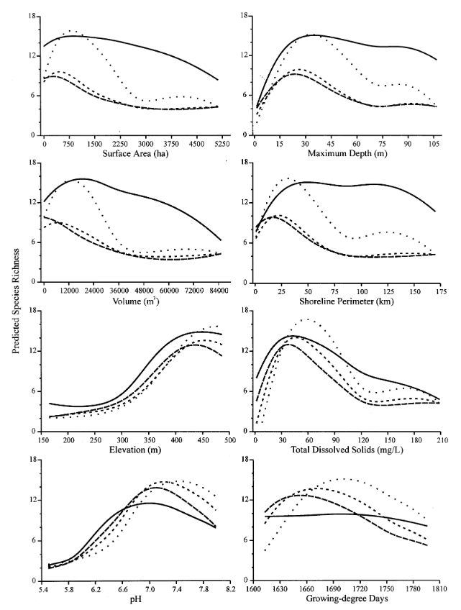

Ancient Methods
Györgyi 1990, Scardi 1999
Add white noise to inputs
Garson 1991, Goh 1995
Measure sum of absolute value of weights
Dapper 1998
SensoNet - Learn a “Sensitivity” Weight for Each Variable
Lek 1995-1999, Özesmi 1998
Vary input variables within some range
Break up into intervals or use summary stats
Construct “Contribution Plots”
Olden et al. 2002- Lek’s Algorithm

Slide 10
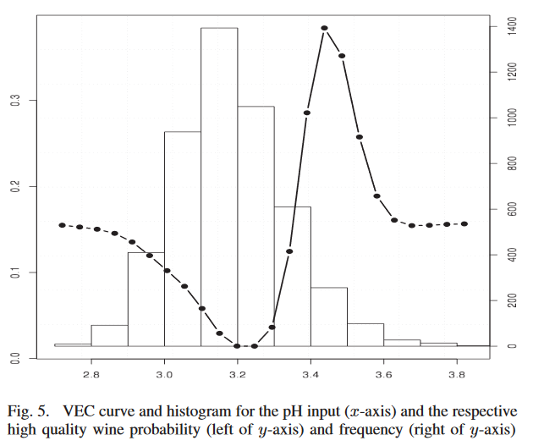
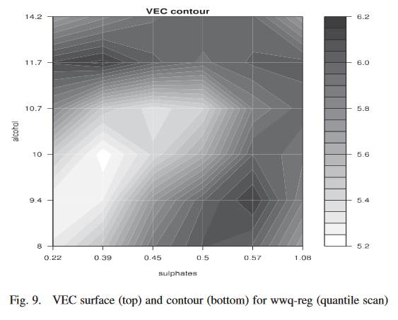

Variable Effect Characteristic Curve
Cortez et al. 2011, 2013
Standard Variable Variation
Some optimizations + proposed similarity metrics
Generalize to Multiple Dimensions
VEC Curve
Measure how output changes on input, and interpolate
VEC Contour
Visualization technique for 2-d variation case

Slide 11
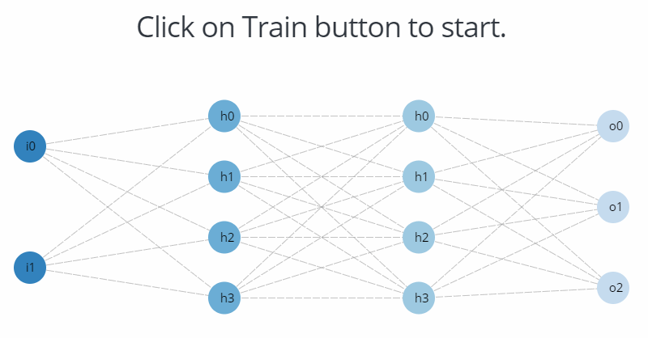
Randomization Approach
Olden et al. 2002
Initially randomize many networks
Select the network with best prediction
Record product of input/output weights for each neuron
Record sum of input/output weights for each variable
Measure importance of input variable with Garson’s Algorithm
Randomly permute the original response variable
Construct a new neural network using new response and initial weights from selected network
repeat steps (3-7d) a large number of times

Slide 12
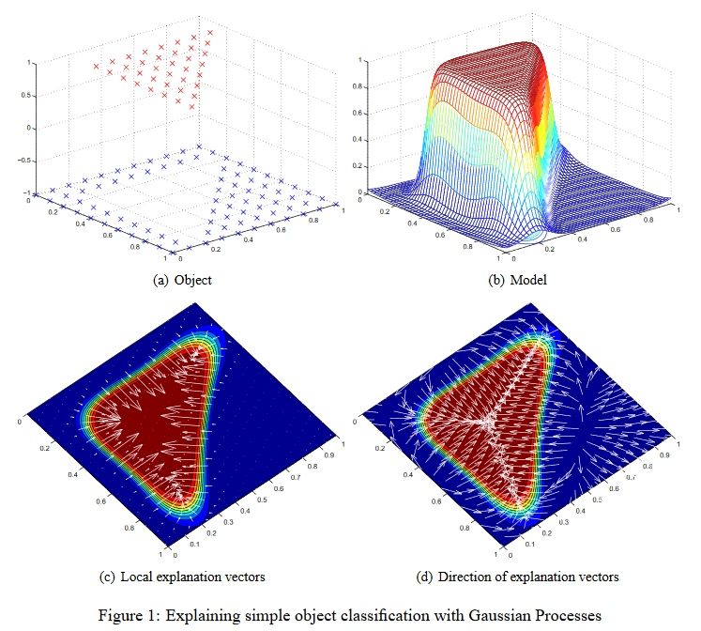



Explanation Vectors for Classification
Bährens et al. 2010
Assuming a Bayesian Classifier
Explanation Vector is Defined as
Local Explanation Vectors
Use estimation when the probability Function is not explicitly available
some heuristics are needed when Derivatives are zero, or don’t exist
Has not been applied to DNNs

Slide 13
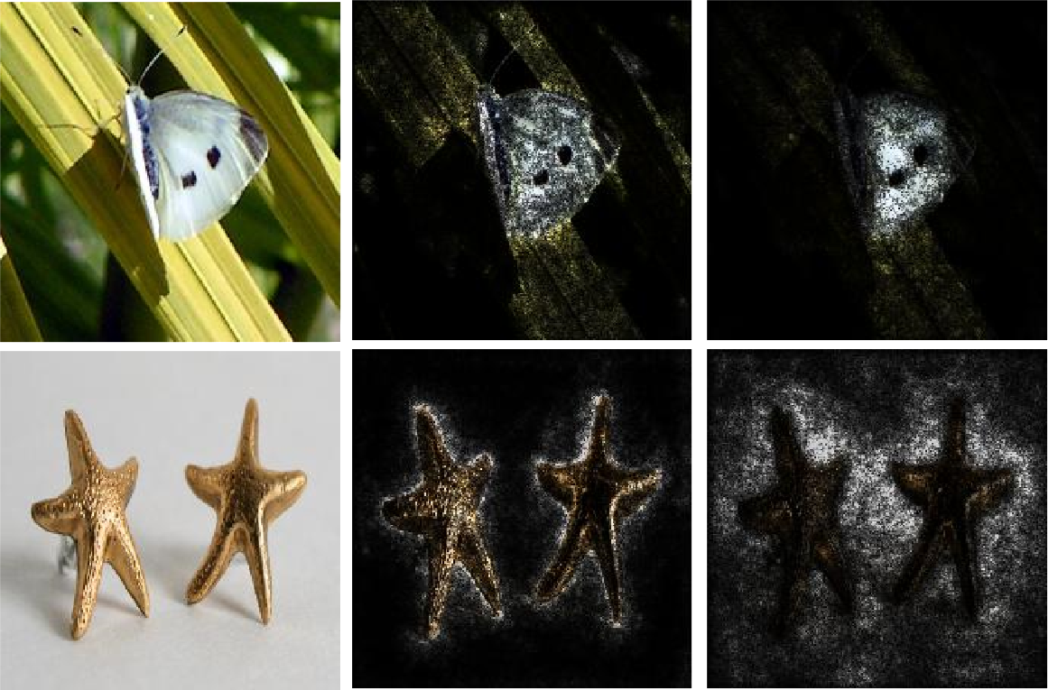
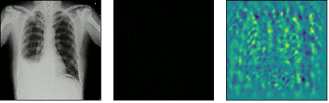

Integrated Gradients
Original IG Gradients
Sundararaja et al. 2017
Proposed “Axioms” for attribution
Sensitivity
Implementation Invariance
Completeness
Take a Walk
Find “Path” From Baseline Input to Actual Input using gradients
Accumulate Gradients via Integration
Original Perturbed Sensitivity Map

Slide 14
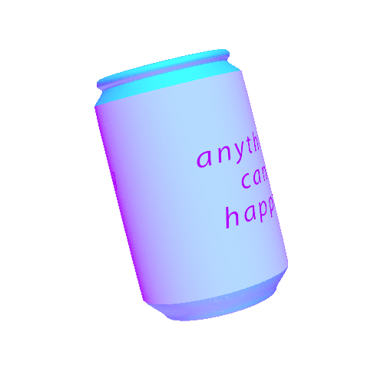
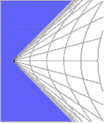
Potential New Methods
Molchanov et al 2019 - Importance Estimation
Similar to Datta et al. 2016 (Quantitative Input Influence)
Computes Importance of Particular parameters
Use second-order Taylor Expansion to avoid computing M^2 computations
Equivalent to Estimating the expected Fisher Information Matrix
Shu et al. 2019 - Information Geometry
Uses a Riemannian manifold defined on the probability space Of outputs conditioned on parameters, inputs, and perturbation
Supposedly can be used to quickly detect pixels in input images which can be perturbed to affect classification

Slide 15
Sensitivity Analysis
What is SA conceptually?
Explain one or two algorithms for SA
Does it use partial derivatives, variance decomposition, something else?
What does it capture and what does it not capture?
https://arxiv.org/pdf/1802.01933.pdf (section 8.1)
Three examples of SA:
https://www.sciencedirect.com/science/article/pii/S0020025512007098
https://arxiv.org/abs/1703.01365
https://www.sciencedirect.com/science/article/pii/S0304380002000649 (briefly covers several methods)

Slide 16
Deconvolution
5 minutes

Slide 17
Deconvolution
How does a convolutional layer work (brief)?
What is deconvolution and how does it work?
What information does it provide?
Primary source for deconvolutions for model interpretation https://arxiv.org/pdf/1311.2901.pdf

Slide 18
Backpropagation Methods

Slide 19
Saliency
What is saliency and the base concept of backpropagation for model interpretation?
What are some popular frameworks?
CAM and grad CAM
What information does it provide?
Where is it lacking?
https://arxiv.org/pdf/1802.01933.pdf (section 7.1)
http://blog.qure.ai/notes/deep-learning-visualization-gradient-based-methods
https://arxiv.org/abs/1610.02391 (grad-CAM)
https://arxiv.org/abs/1512.04150 (CAM)

Slide 20
Saliency

Slide 21
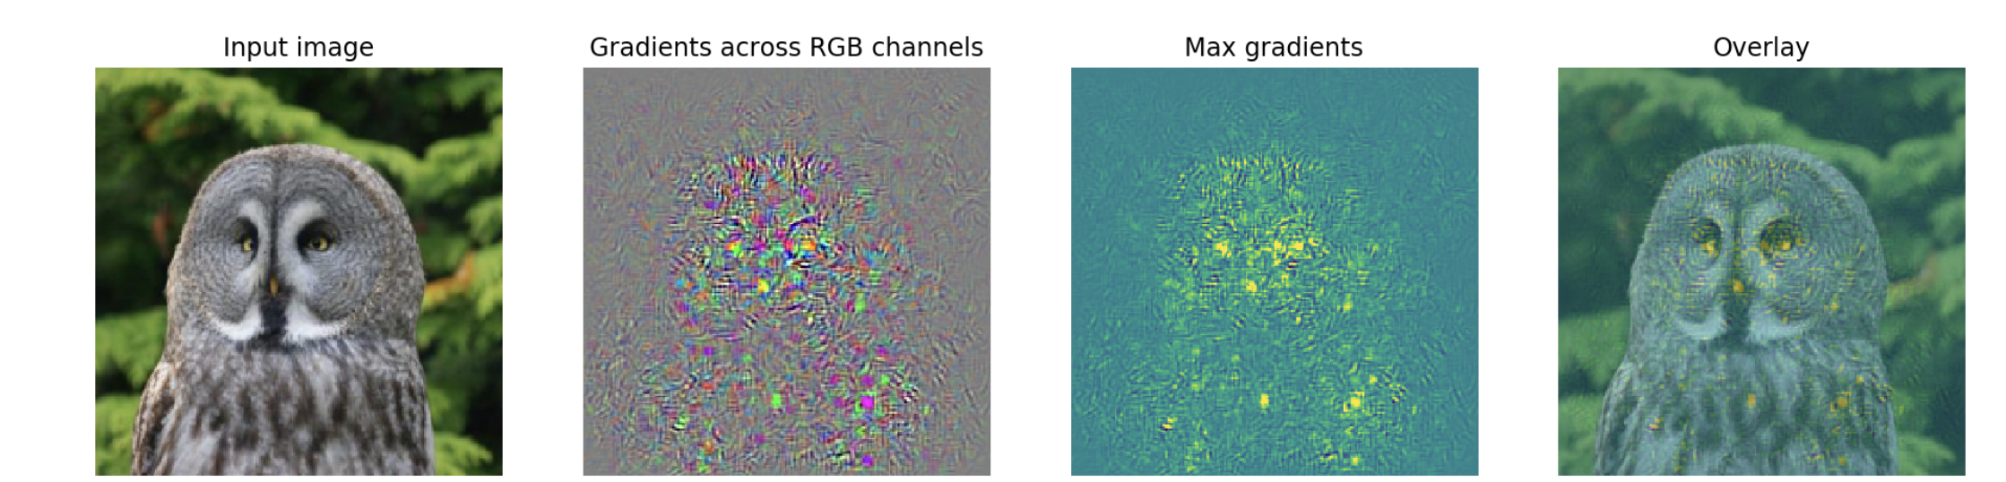
Saliency
Calculates dy/dx to be projected onto the input
Calculate the scalar gradient from a given class c w.r.t. pixel x_{i} to give heatmap L
Overlay input image x with L

Slide 22
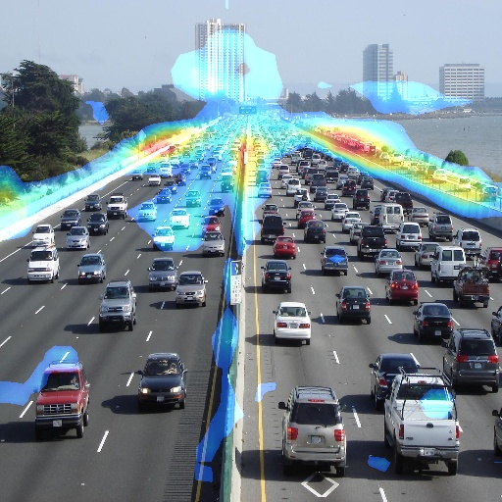

Class Activation Mapping (CAM)
Uses a global average pooling (GAP) layer as final layer
GAP converts the activated final convolutional layer (A_{k}) into a scalar a_{k} for all K channels of the previous layer
A final linear layer learns the prediction
A single weight value (w) connects the pooling layer to each output class, c
This weight value is multiplied with the activated convolutional layer and summed over all channels
Scale L to the size of x and overlay
Model must train with GAP layer

Slide 23

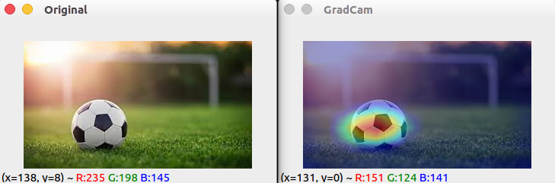
Gradient-weighted CAM (grad-CAM)
grad-CAM does not require retraining with a GAP layer
Gradients from a class are propagated to each channel of the final convolutional layer
The weighted channels are summed together and passed through a ReLU to provide the final map
Given channel k of
convolutional layer A and gradient w from class c w.r.t. A:

Slide 24
Interpretable Inputs

Slide 25

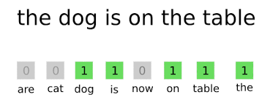
Interpretable Inputs
Inputs (X) understandable by humans but not by machines
Text, images, etc
x=h(X’)
Where h(X’) maps values interpretable by a machine X’ to raw data such as text
Binary representations of text, bag-of-words, etc

Slide 26
LIME
Local Interpretable Model-agnostic Explanations

Slide 27



LIME
Given trained predictor f, with inputs X, X’
Randomly sample around image x’_{i} for z’_{i}
Given some linear classifier g (i.e. linear regression) and distance formula D:
Ω(g) is a time complexity constraint
LASSO can be used to find the best set of features

Slide 28
LIME - example (spam prediction)
We classify text as spam or not spam
Given spam input, x = “For Christmas Song visit my channel! :)”
Perturbation of x: z = “For Song visit my channel! ;)”
Z’ = [1, 0, 1, 1, 1, 1, 1]
For words present or not present of the perturbed sample
The distance between x and z is the number of removed words
𝜋_{x}(z) = .86
f(“For Song visit my channel! ;)”) = prediction of this sentence in original model = f(z)
g( [1, 0, 1, 1, 1, 1, 1]) = linear model trained over interpretable inputs
Loss = 𝜋_{x}(z) [f(“For Song visit my channel! ;)”) - g( [1, 0, 1, 1, 1, 1, 1])]²

Slide 29
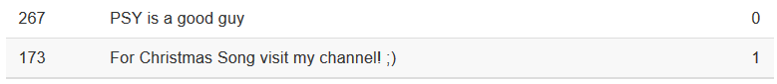
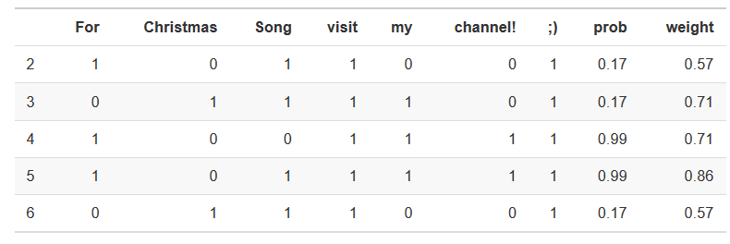
LIME - example (spam prediction)
We see that when Channel is removed, the probability drops dramatically. Weight is based on number of words dropped

Slide 30
Shapley Values

Slide 31
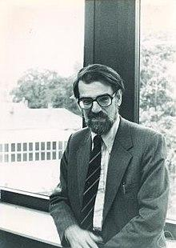

Shapley Values
Shapley values, as defined by game theory, are feature importances for multivariate linear models
Uses all subsets of input features to calculate importance values for all features
Where i is a selected feature, and S is a given subset of all features F excluding i.
f_{S⋃i}(x_{S⋃i}) is the function with feature i in place and f_{s}(x_{s}) is the model wherein i has been removed

Slide 32

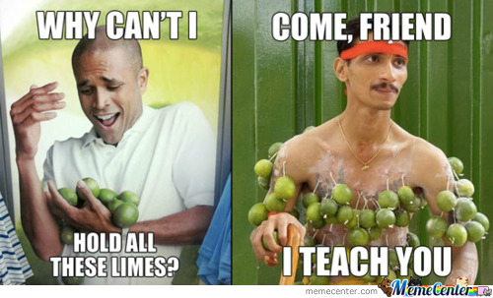
Shapley Values using LIME
Where M is the number of features (words in our sentence) and |z| is the size of the subset
We see the same equation from LIME with a different weight function

